Slide 1

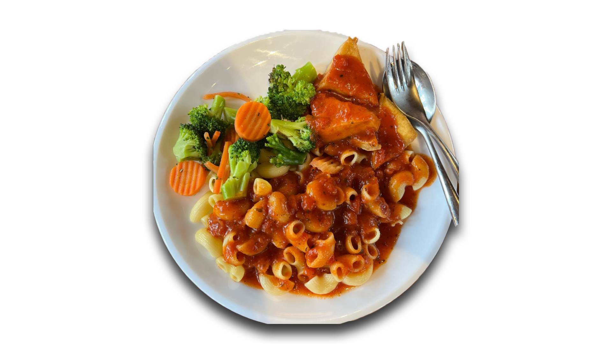
GRAB AND GO
A PYTHON-based PROJECT
Vibilan Jayanth
Nathan Wongkar
Jeff Winxin Collado
Dabeer Ahmed

Slide 2

GRAB AND GO
is a python-based
task automated project, where we scrape data of SATS website and provide you with the healthiest food options (for every meal!)

Slide 3


IMPORTANCE/motive
WHY ARE WE DOING THIS?
Importance of food intake
(Sad story huhu)
Convenience and efficiency (who doesn’t wanna save time)
Nutrition
(lez be healthy!)

Slide 4

In simpler words…
We aim to improve your eating habits through a simple and effective automated task.
We also don’t want to give you EDs....

Slide 5

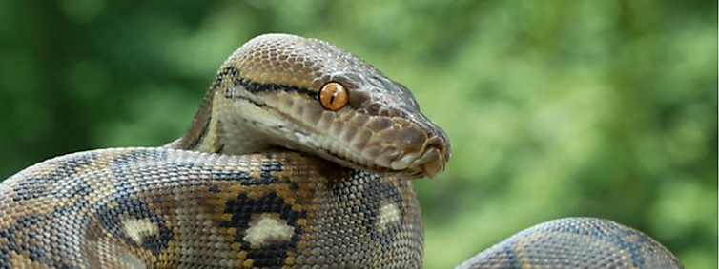
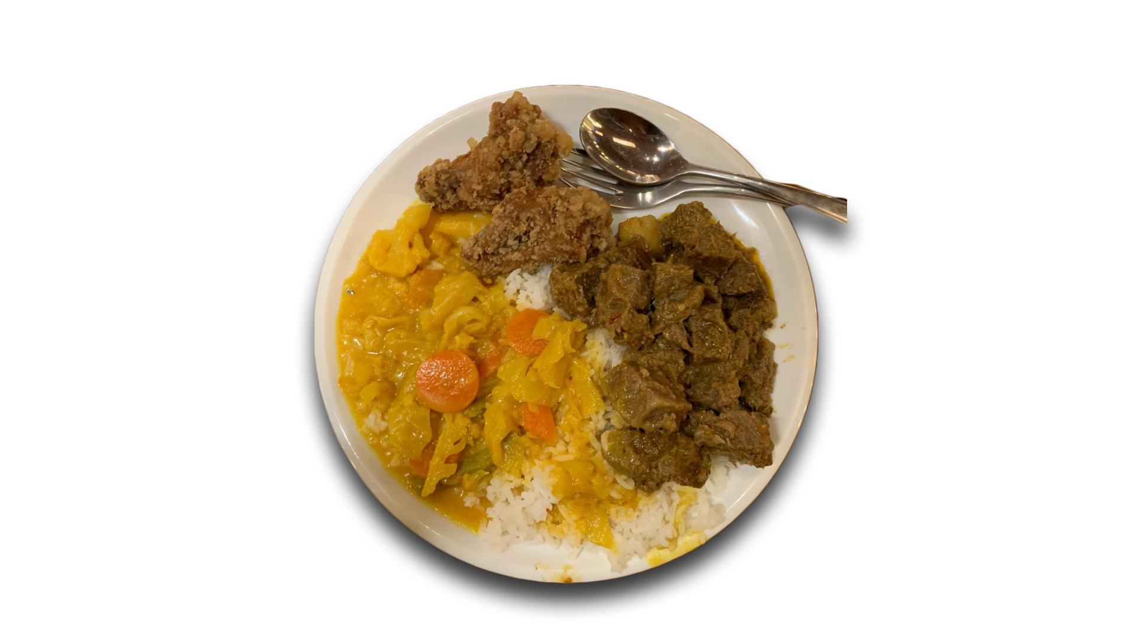
SO HOW?
Using python…

Slide 6

Manual task
Automated task
Scrapes data off SATS website
Sends the food name with the highest protein content in percentage for each meal.
Additionally, we get the total calorie associated with the meal
Finally, it sums up the total calories and macros (protein, fats, and carbohydrates) for all the meals, and presents it!
Entering Credentials in the SATS website

Slide 7
Future improvements
Where can future developers innovate?
Creation of Channel
Instead of just Telegram bot, a channel on its own can be created.
More Messaging Options
Wide variation of message accessibility: Whatsapp, Email, etc.
More Dietary Info
Inclusion of other information for dietary information or allergies.
Preference Customization
“Do you want to prioritize protein or not?”

Slide 8
GRAB AND GO
A PYTHON-based PROJECT
THANK YOU SO MUCH!
Vibilan Jayanth
Nathan Wongkar
Jeff Winxin Collado
Dabeer Ahmed

